Slide 1



Slide 2

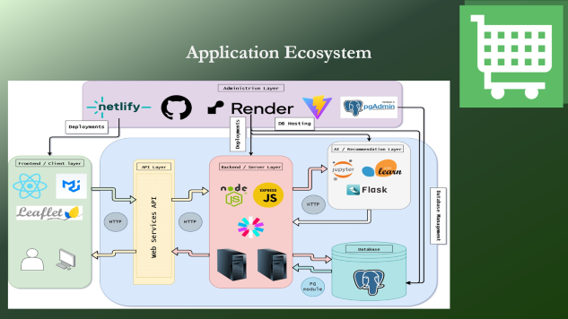
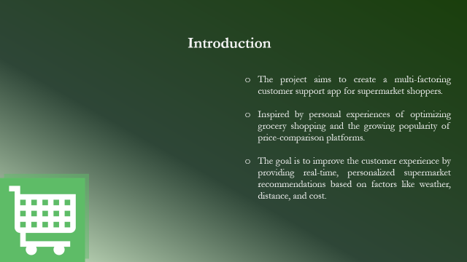


Slide 3

Design and Development of a
Location-Based Customer Support Application for Supermarkets
Author: Panagiotis Arvanitis
Supervisor: Nikolaos Avouris
Institution: University of Patras, Department of Electrical and Computer Engineering

Slide 4
Introduction
The project aims to create a multi-factoring customer support app for supermarket shoppers.
Inspired by personal experiences of optimizing grocery shopping and the growing popularity of price-comparison platforms.
The goal is to improve the customer experience by providing real-time, personalized supermarket recommendations based on factors like weather, distance, and cost.

Slide 5
Objective of the Application
Develop an application that recommends the best supermarket based on a variety of user criteria such as real-time data such as weather, distance, transportation means, and time of day.
Leverage AI and machine learning to provide optimal shopping recommendations tailored to each users needs.

Slide 6
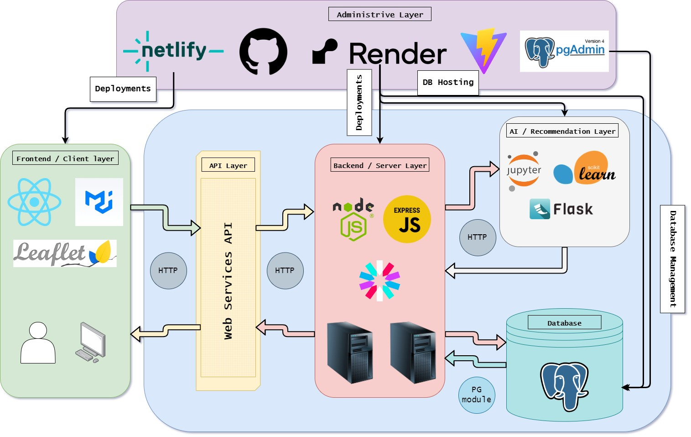
Application Ecosystem

Slide 7

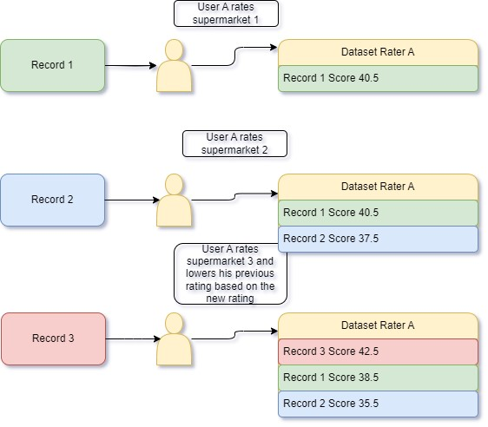
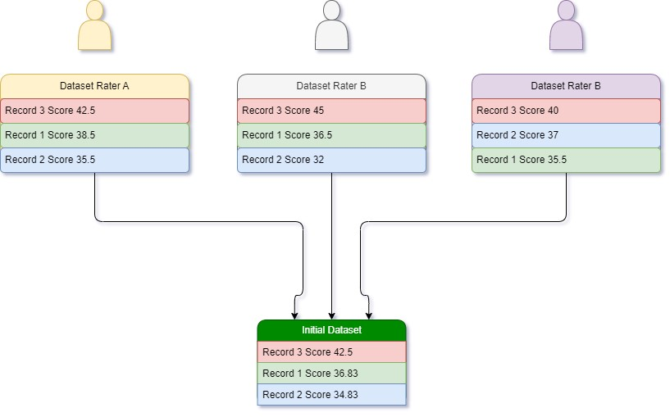
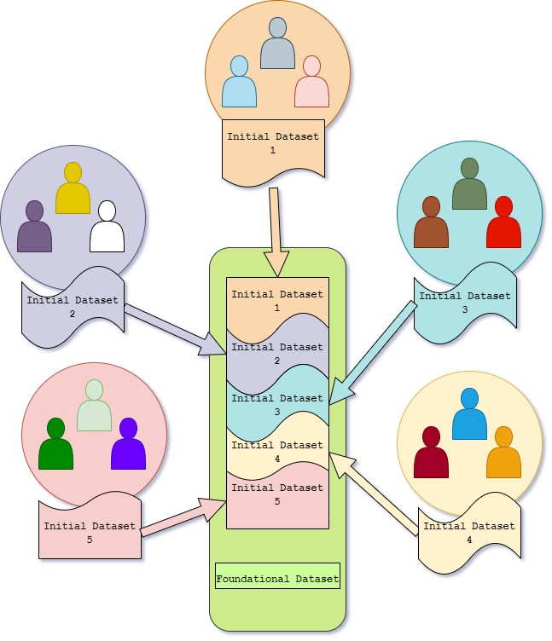
Dataset Creation
Single Person Ratings
Sequential Rating Process
Dynamic Rating Adjustment
Single Group Ratings
Mean Calculation
Combination of Groups Ratings
Repetition of previous steps
Merging
Repetition of previous process
Merging

Slide 8

Single Person Ratings
Single Group Ratings
Combination of Groups Ratings
Sequential Rating Process
Dynamic Rating Adjustment
Mean Calculation
Repetition of previous process
Merging
Dataset Creation

Slide 9
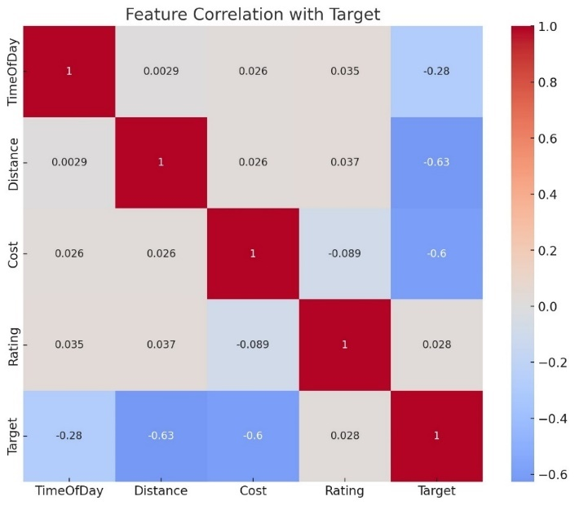
• Rating has a very low positive correlation with the target (0.028), indicating that changes in ratings have little to no linear relationship with the target.
• TimeOfDay shows a moderate negative correlation with the target (-0.279), suggesting that as the time of day increases, the target tends to decrease.
• Cost has a strong negative correlation with the target (-0.600), indicating that higher costs are associated with lower target values.
• Distance shows the strongest negative correlation with the target (-0.627), suggesting that longer distances are strongly associated with lower target values.

Slide 10
• Rating has a very low positive correlation with the target (0.028), indicating that changes in ratings have little to no linear relationship with the target.
• TimeOfDay shows a moderate negative correlation with the target (-0.279), suggesting that as the time of day increases, the target tends to decrease.
• Cost has a strong negative correlation with the target (-0.600), indicating that higher costs are associated with lower target values.
• Distance shows the strongest negative correlation with the target (-0.627), suggesting that longer distances are strongly associated with lower target values.

Slide 11


Slide 13
What is AI powered synthetic data generation and how does it work?
Synthetic data generation is powered by deep generative algorithms. These algorithms use data samples as training data to learn the correlations, statistical properties, and data structures. Once trained, the algorithms can generate data that is statistically and structurally identical to the original training data, while ensuring all data points are synthetic.
Key Points about synthetic data:
Synthetic data for AI and machine learning is more flexible than real data. It accelerates analytics development cycles, reduces regulatory concerns, and lowers data acquisition costs by providing tailored datasets for specific applications.
An initial dataset is required. An initial dataset needs to be constructed and fed to the synthetic data generation model in order to increase it’s volume in order to be substantial for the recommendation model

Slide 14
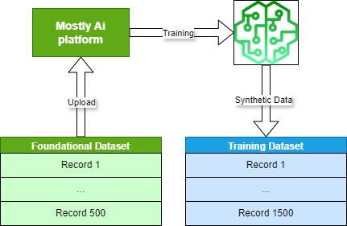
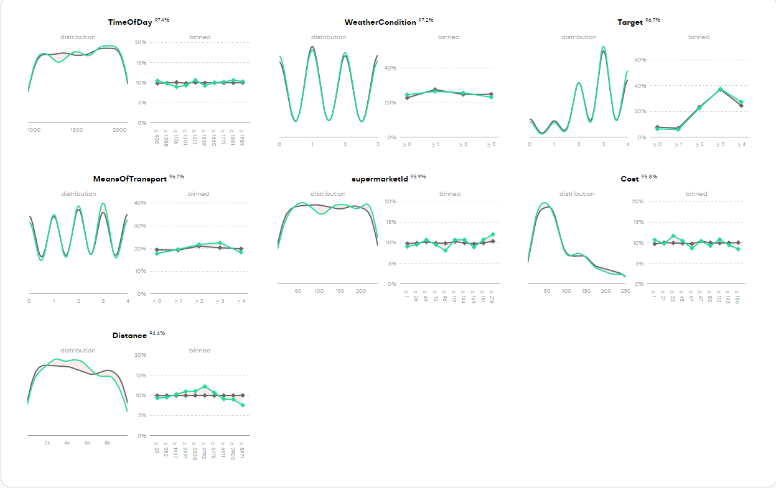
What is AI powered synthetic data generation and how does it work?
Synthetic data generation is powered by deep generative algorithms. These algorithms use data samples as training data to learn the correlations, statistical properties, and data structures. Once trained, the algorithms can generate data that is statistically and structurally identical to the original training data, while ensuring all data points are synthetic.
Key Points about synthetic data:
Synthetic data for AI and machine learning is more flexible than real data. It accelerates analytics development cycles, reduces regulatory concerns, and lowers data acquisition costs by providing tailored datasets for specific applications.
An initial dataset is required. An initial dataset needs to be constructed and fed to the synthetic data generation model in order to increase it’s volume in order to be substantial for the recommendation model

Slide 15
GBR is commonly used in gaming to calculate complex scoring systems by analyzing player behaviors and patterns.
Just like in games where it predicts and adjusts player scores based on numerous inputs, it’s ideal for our recommendation system. It was a natural first thougt for scoring supermarkets based on real-time conditions and user preferences.
Initial Inspiration
Why GBR?
Benefits
Problem Complexity: The recommendation problem involves multiple factors like distance, cost, weather conditions, and transportation means. A simple model wouldn’t effectively weigh and combine these diverse inputs.
Non-Linear Relationships: GBR excels in capturing non-linear relationships between features (e.g., how weather and transportation influence a user’s choice of supermarket).
Handling Multiple Variables: GBR processes various input factors simultaneously, delivering more accurate, personalized recommendations.
High Accuracy:
Sequentially improves by correcting errors from previous iterations, enhancing recommendation accuracy.
Flexibility:
Handles various input types (e.g., continuous, categorical), making it suitable for predicting shopping decisions based on dynamic factors.
Avoids Overfitting:
Features like shrinkage (learning rate) and tree pruning ensure the model generalizes well in different environments (e.g., controlled tests and real-world usage).
Handles Noisy Data:
GBR is robust enough to deal with missing or inconsistent data, common in real-world applications like supermarket recommendations.

Slide 16
GBR is commonly used in gaming to calculate complex scoring systems by analyzing player behaviors and patterns.
Just like in games where it predicts and adjusts player scores based on numerous inputs, it’s ideal for our recommendation system. It was a natural first thougt for scoring supermarkets based on real-time conditions and user preferences.
Problem Complexity: The recommendation problem involves multiple factors like distance, cost, weather conditions, and transportation means. A simple model wouldn’t effectively weigh and combine these diverse inputs.
Non-Linear Relationships: GBR excels in capturing non-linear relationships between features (e.g., how weather and transportation influence a user’s choice of supermarket).
Handling Multiple Variables: GBR processes various input factors simultaneously, delivering more accurate, personalized recommendations.
Initial Inspiration
Why GBR?
Benefits
High Accuracy:
Sequentially improves by correcting errors from previous iterations, enhancing recommendation accuracy.
Flexibility:
Handles various input types (e.g., continuous, categorical), making it suitable for predicting shopping decisions based on dynamic factors.
Avoids Overfitting:
Features like shrinkage (learning rate) and tree pruning ensure the model generalizes well in different environments (e.g., controlled tests and real-world usage).
Handles Noisy Data:
GBR is robust enough to deal with missing or inconsistent data, common in real-world applications like supermarket recommendations.

Slide 17
GBR is commonly used in gaming to calculate complex scoring systems by analyzing player behaviors and patterns.
Just like in games where it predicts and adjusts player scores based on numerous inputs, it’s ideal for our recommendation system. It was a natural first thougt for scoring supermarkets based on real-time conditions and user preferences.
Problem Complexity: The recommendation problem involves multiple factors like distance, cost, weather conditions, and transportation means. A simple model wouldn’t effectively weigh and combine these diverse inputs.
Non-Linear Relationships: GBR excels in capturing non-linear relationships between features (e.g., how weather and transportation influence a user’s choice of supermarket).
Handling Multiple Variables: GBR processes various input factors simultaneously, delivering more accurate, personalized recommendations.
High Accuracy:
Sequentially improves by correcting errors from previous iterations, enhancing recommendation accuracy.
Flexibility:
Handles various input types (e.g., continuous, categorical), making it suitable for predicting shopping decisions based on dynamic factors.
Avoids Overfitting:
Features like shrinkage (learning rate) and tree pruning ensure the model generalizes well in different environments (e.g., controlled tests and real-world usage).
Handles Noisy Data:
GBR is robust enough to deal with missing or inconsistent data, common in real-world applications like supermarket recommendations.
Initial Inspiration
Why GBR?
Benefits

Slide 19
Front-End
React
Material UI
Leaflet

Slide 20
Back-End
Node.js
Express.js

Slide 21
Python Server
scikit-learn
Flask
Jupyter

Slide 22
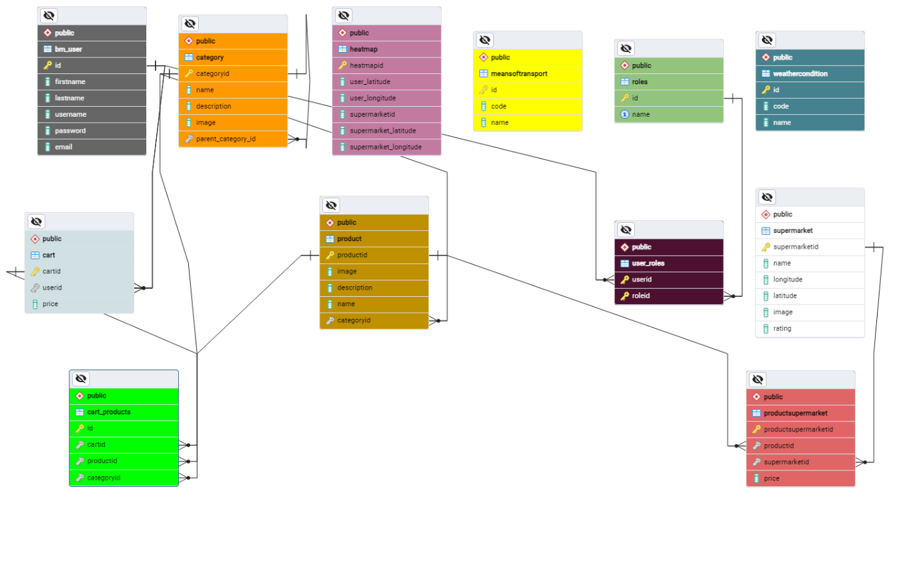
Database
PostgreSQL

Slide 23
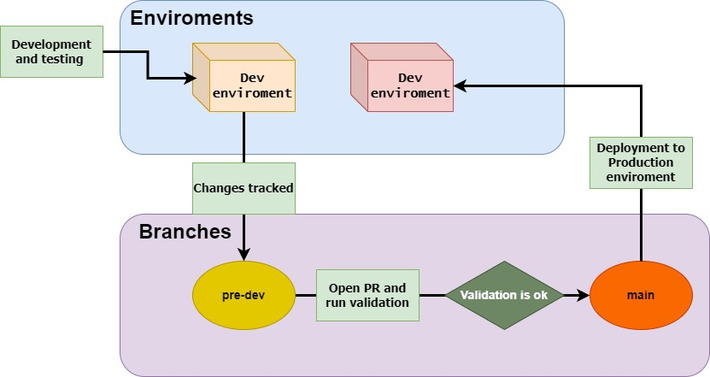
Administrive layer
Versioning and Deployments

